Slide 1

Microsoft Office
PowerPoint Quick Start Guides
A Lumon Industries PowerPoint Presentation Template by @dstoryco

Slide 2


Slide 3

UNITED IN SEVERANCE

Slide 4
Valued Lumon Employee,
No individual is more appreciated than you, NAME.
Your adherence to standards in JOB TITLE has been noticed.
Please enjoy one (1) free package of raisins, shriveled.
COPYRIGHT LUMON INDUSTRIES, INC.
ALL RIGHTS RESERVED
PRINTED IN U.S.A.

Slide 5
Please try to enjoy each fact equally.

Slide 6
The work is mysterious and important

Slide 7
A handshake is available upon request.

Slide 8
The board will not be contributing to this meeting verbally.

Slide 9

OPTICS AND DESIGN

Slide 10
MACRODATA
REFINEMENT

Slide 11
SVR’D ACCESS

Slide 12


Senior Refiner
Morning Checklist
MACRODATA REFINEMENT
The following should be completed before commencing the day’s work
Remember! You are permitted one record to listen to each morning during your morning checklist procedures. Which will you choose today?
Brew a pot of coffee.
Refill the soap dispenser in the restroom
Dust the Lumon Compliance Handbook and Appendices
Acknowledge Kier Eagan Portrait (verbally or silently).
Self-Assess: Can I lead today?

Slide 13

Artwork
Request Form
OPTICS & DESIGN
Once your selection has been received, your artwork will be hung in a timely manner.
Approved artwork serves to invigorate your co-workers and increase productivity. Which will you select this month?
Kier Eagan portrait
The Core Principles
“Kier Tames the Four Tempers”
“The Youthful Convalescence of Kier”
The Grim Barbarity of Optics and Design

Slide 14

Senior Refiner
Valentine’s Day Party Checklist
MACRODATA REFINEMENT
Please relax and be open to these gifts and perform the party setup according to this checklist.
Remember! Please complete each step, and enjoy each equally. Happy Valentine’s Day!
Open box and enjoy the note inside.
Use pen to successfully complete this checklist.
Inflate balloon, set on desk to the left of your computer.
Place updated team photo on desk to the right of your computer.
Place your new planet beside your team photo.

Slide 15
The Wellness Center
Patient Outie Facts
These facts should be very pleasing.
Relax your body and be open to the facts.
Try and enjoy each equally.
These facts are not to be shared outside this room.
For now, they are yours to enjoy.
Your outie is generous
Your outie is fond of music and owns many records
Your outie is a friend to children, to the elderly, and the insane
Your outie values water
Your outie likes the sound of radar
Your outie is skilled at PowerPoint and slide-making

Slide 16
MUSIC EXPERIENCE
(CHOOSE ONE)
BAWDY FUNK
BUOYANT REGGAGE
DEFIANT JAZZ
EFFUSIVE SKA
HOOTIN’ TOOTIN’ COUNTRY
SPOOKY AMBIENT
RECKLESS DISCO
THOUGHTFUL GRUNGE

Slide 17

Siena
70% Complete
9
6
1
0
7
8
3
6
5
7
6
5
2
1
2
1
0
7
8
7
2
5
8
8
1
0
5
6
9
6
9
2
3
8
5
4
5
3
0
5
4
1
4
1
8
9
8
5
6
9
6
7
4
6
8
3
2
5
4
7
3
8
1
0
5
0
1
5
8
7
8
5
2
9
0
7
2
3
2
9
0
2
3
4
7
0
7
0
3
6
9
2
2
6
9
7
2
3
7
5
8
7
5
6
3
8
5
6
3
2
8
1
4
4
7
8
9
2
8
1
1
4
5
4
3
7
2
3
4
3
6
5
0
1
6
9
6
5
0
7
01
02
03
04
05
36%
95%
54%
76%
90%
Ox137E12 : Ox098CFD

Slide 18
Helly.
a severed story

Slide 19
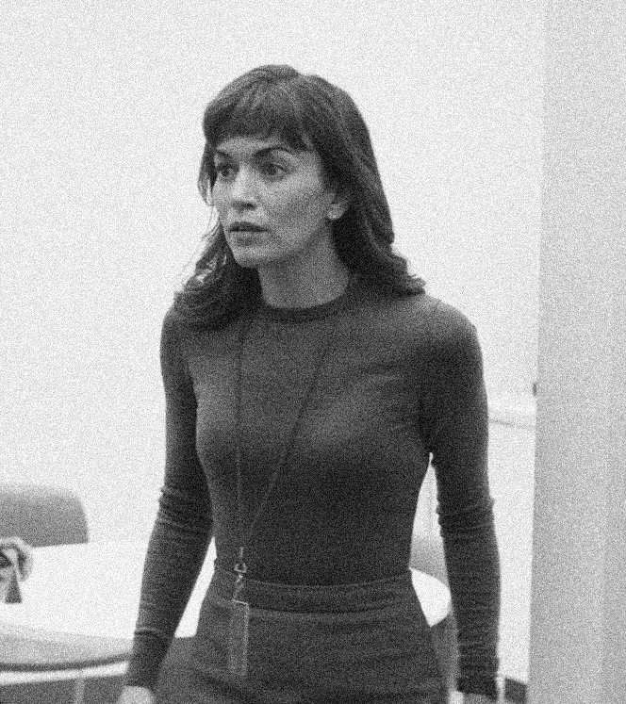
Helly.
a severed story

Slide 20
Let not weakness live in your veins
Kier Eagan

Slide 21

HELLO, HELLY!

Slide 22
GOODBYE, BURT!

Slide 23

WELCOME FRIENDS OF

Slide 24

Advanced Technology
SEVERANCE
MICROCHIP TECHNOLOGY
Contains 1 individually-packaged sterile Severance Chip
Don’t live to work. Work to live.

Slide 25
ALL RIGHTS OF THE OWNER OF THE RECORDED WORK COPYRIGHT LUMON INDUSTRIES INC. UNAUTHORIZED PUBLIC PERFORMANCE, BROADCASTING AND COPYING OF THE RECORD PROHIBUTED.
STEREO
45 RPM
Recorded in the U.S.A.
SIDE A
All Rights Reserved
Lumon Industries Inc.
INNIE RETIREMENT SONG
NO. 19
INNIE RETIREMENT SONG
NO. 19
COPYRIGHT LUMON INDUSTRIES, INC.
ALL RIGHTS RESERVED

Slide 26

I DON’T WANT TO WORK HERE

Slide 29
Designed by
D Story Productions

Slide 30
Macrodata Refinement
Barney Y
Optics & Design
Vickie L
Department of Severed Floor
Adeline C

Slide 31
Follow us on
@dstoryco Instagram
@dstoryco TikTok
D Story LinkedIn

Slide 32




